Slide 1
CMPE 493 Information Retrieval Term Project Final Presentation
Mansur YeşİLBursa
Can Devecİ
Abdullah Yıldız

Slide 2
Overview
Mansur Yeşilbursa
Before Progress Presentations
Can Deveci
After Progress Presentations & Official Evaluations
Abdullah Yıldız
Future Work

Slide 3
Baseline System
Exact Match
On Training Set
Accuracy: 22% on dev set
On Ontology
Accuracy: 33% on dev set (+11%)
Lemmatization
Accuracy: 37% on dev set (+4%)
Abbreviation Resolution
Accuracy: 37% on dev set (~0%)

Slide 4
Baseline System
TF-IDF
If exact match is not possible
Cosine similarity of vectors
TF: binary, IDF: unary [1]
Accuracy: 47% on dev set (+10%)

Slide 5
Baseline Results
Algorithms | Model Improvement | Accuracy
Exact Match (Train + Ontology) | NA | 33%
Lemmatization | 4% | 37%
TF-IDF | 10% | 47%

Slide 6
Models
Tried 9 new models
Developed in an evolutionary way

Slide 7
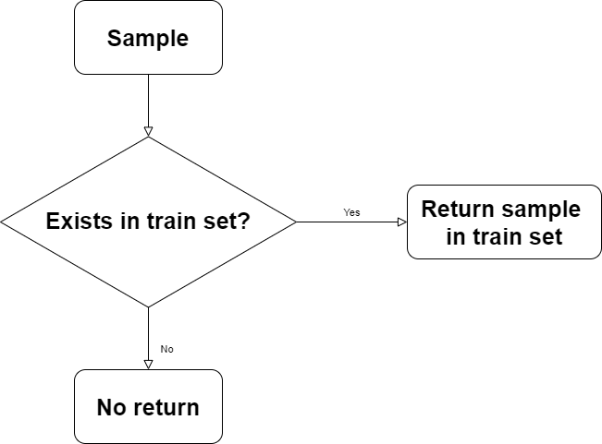
Model 1
MS | H | H (Exact) | H (NiD) | H (NiT) | H (OUFN)
0.1275 | 0.2451 | 0.2235 | 0.000 | NA | 0.1374

Slide 8
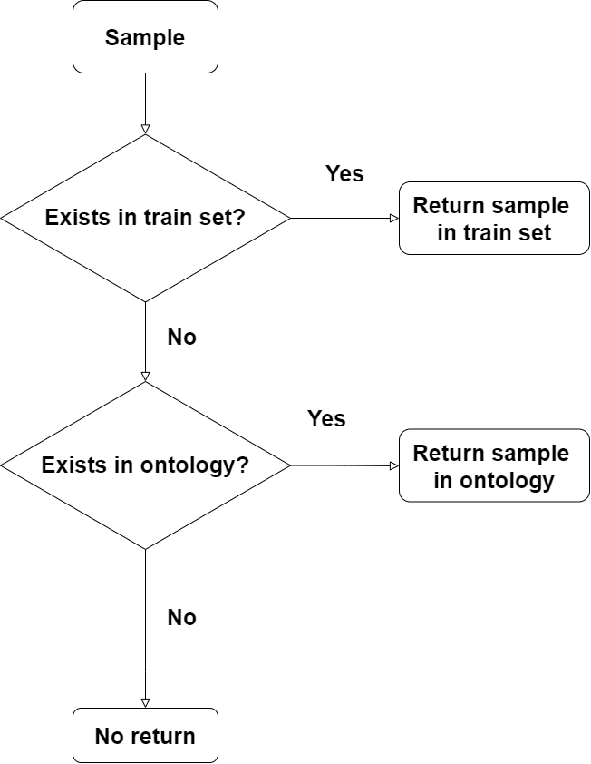
Model 2
MS | H | H (Exact) | H (NiD) | H (NiT) | H (OUFN)
0.1908 | 0.3669 | 0.3448 | 0.2597 | 0.000 | 0.2112

Slide 9
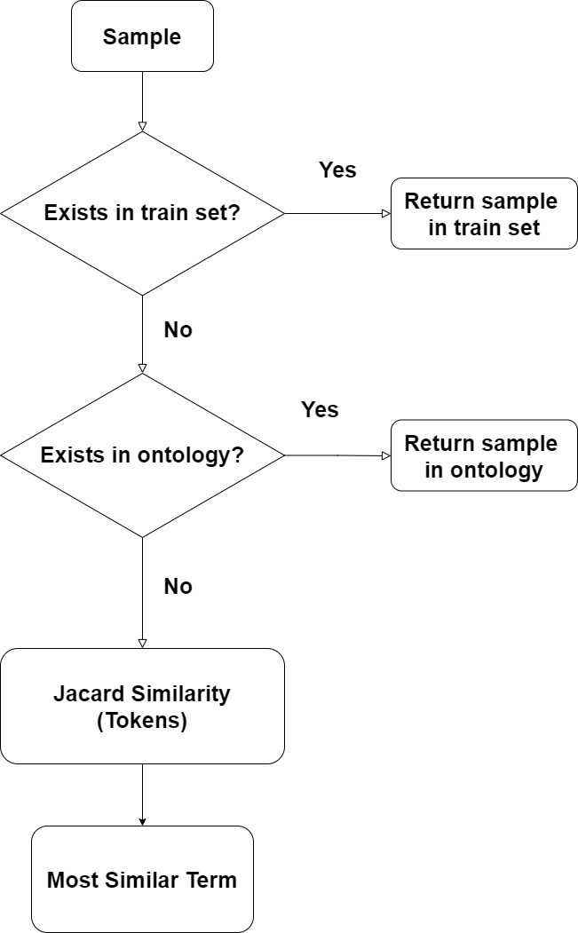
Model 3
MS | H | H (Exact) | H (NiD) | H (NiT) | H (OUFN)
0.3380 | 0.6500 | 0.5320 | 0.4469 | 0.000 | 0.5538

Slide 10
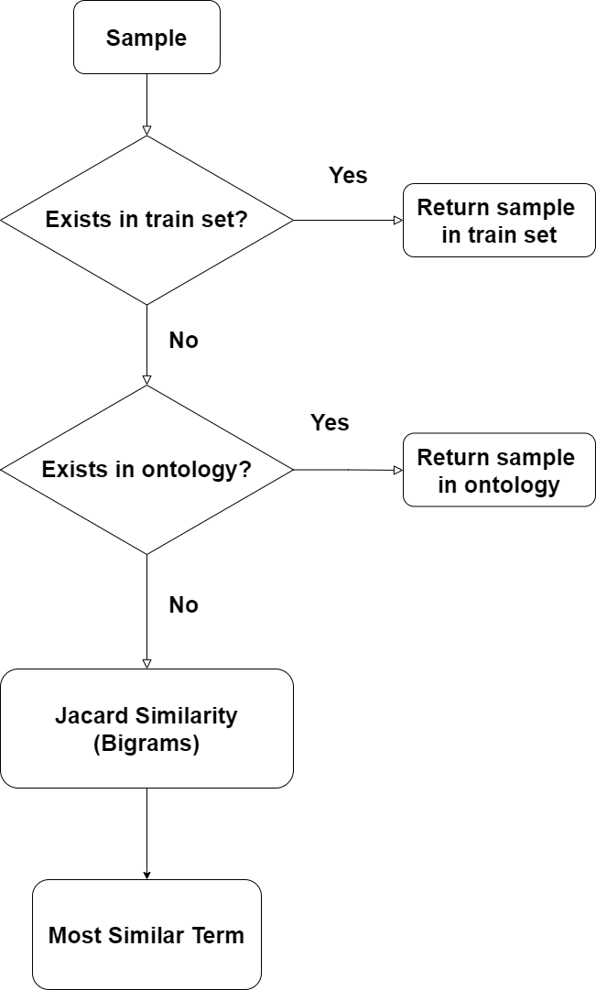
Model 4
MS | H | H (Exact) | H (NiD) | H (NiT) | H (OUFN)
0.3665 | 0.7047 | 0.5784 | 0.5154 | 0.000 | 0.6168

Slide 11
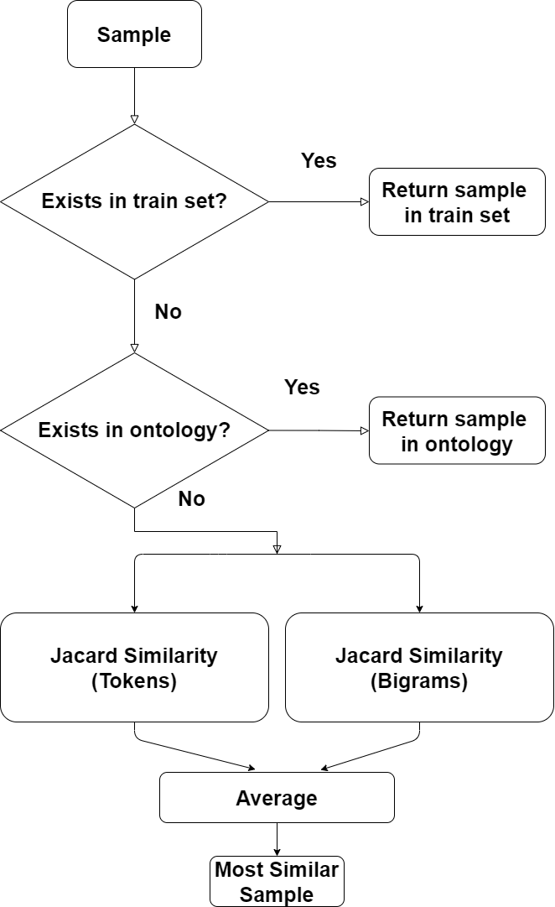
Model 5
MS | H | H (Exact) | H (NiD) | H (NiT) | H (OUFN)
0.3819 | 0.7344 | 0.6121 | 0.5169 | 0.000 | 0.6547

Slide 12
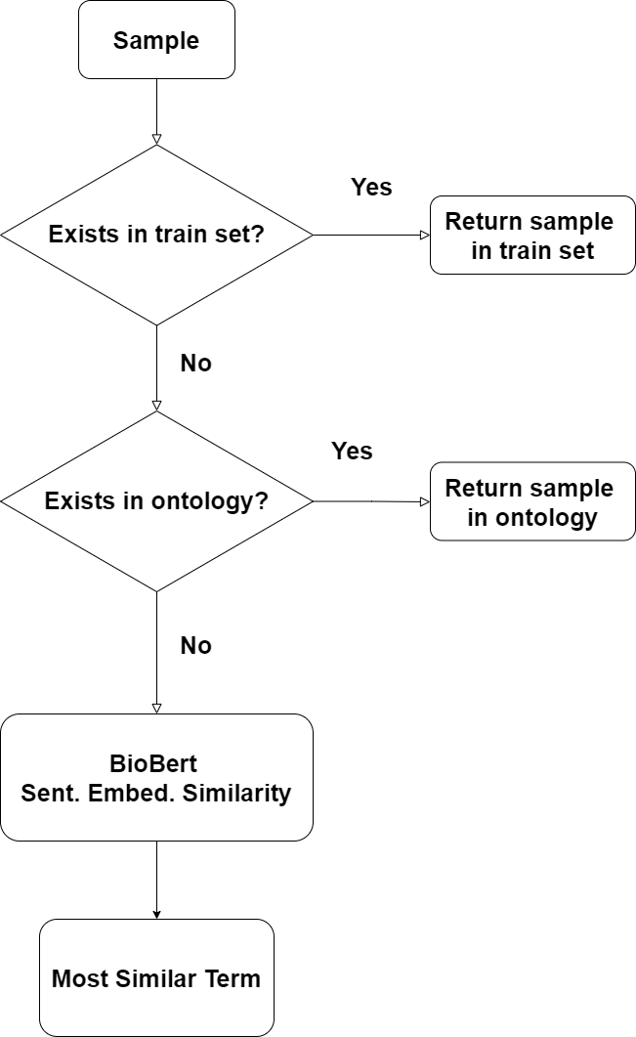
Model 6
MS | H | H (Exact) | H (NiD) | H (NiT) | H (OUFN)
0.3409 | 0.6555 | 0.4639 | 0.3135 | 0.000 | 0.5908

Slide 13
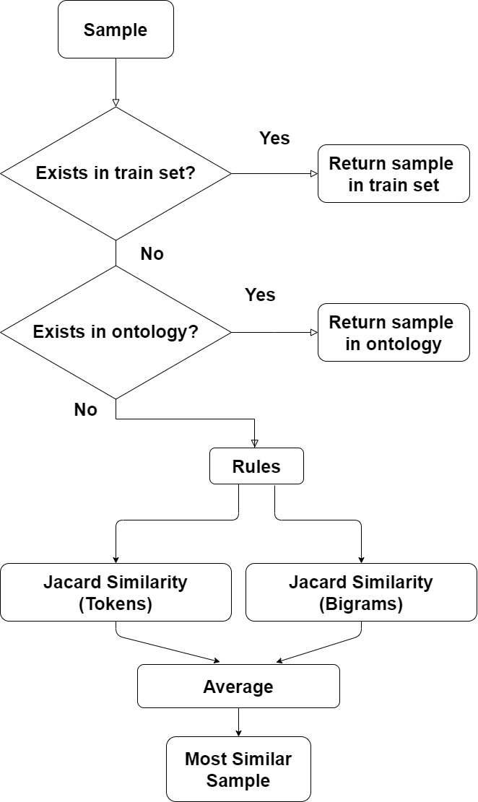
Model 7
MS | H | H (Exact) | H (NiD) | H (NiT) | H (OUFN)
0.4071 | 0.7829 | 0.6651 | 0.6202 | 0.000 | 0.7310

Slide 14
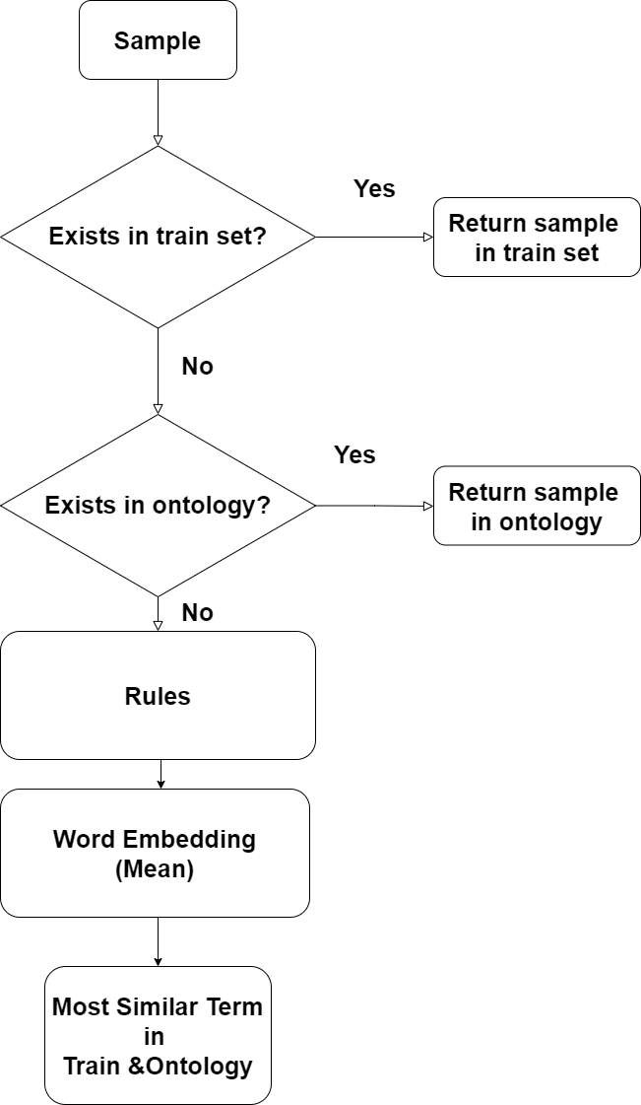
Model 8
 | MS | H | H (Exact) | H (NiD) | H (NiT) | H (OUFN)
Dev | 0.4281 | 0.8233 | 0.6951 | 0.6443 | 0.0000 | 0.7732
Test(*) | 0.3673 | 0.7219 | 0.5487 | 0.4906 | 0.09639 | 0.6962

Slide 15
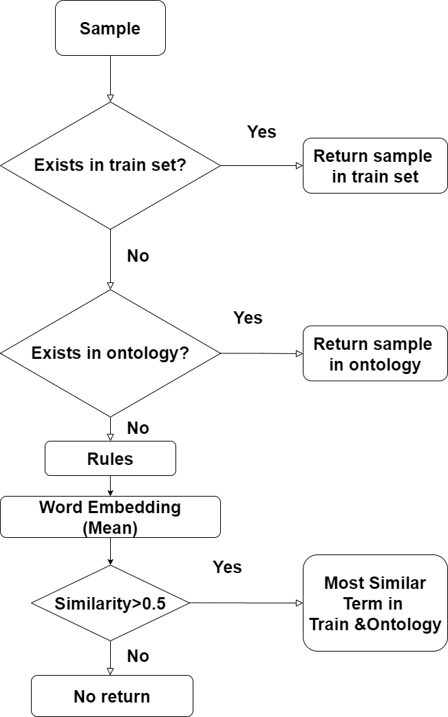
Model 9
MS | H | H (Exact) | H (NiD) | H (NiT) | H (OUFN)
0.4276 | 0.8222 | 0.6951 | 0.6443 | 0.000 | 0.7714

Slide 16
Overall Progress
Alg. | Set | MS | H | H (Exact) | H (NiD) | H (NiT) | H (OUFN)
EMT | Dev | 0.1275 | 0.2451 | 0.2235 | 0.000 | NA | 0.1374
EMTO | Dev | 0.1908 | 0.3669 | 0.3448 | 0.2597 | 0.000 | 0.2112
EMTO JT | Dev | 0.3380 | 0.6500 | 0.5320 | 0.4469 | 0.000 | 0.5538
EMTO JBi | Dev | 0.3665 | 0.7047 | 0.5784 | 0.5154 | 0.000 | 0.6168
EMTO JA | Dev | 0.3819 | 0.7344 | 0.6121 | 0.5169 | 0.000 | 0.6547
EMBB | Dev | 0.3409 | 0.6555 | 0.4639 | 0.3135 | 0.000 | 0.5908
EMTO JAR | Dev | 0.4071 | 0.7829 | 0.6651 | 0.6202 | 0.000 | 0.7310
EMTO RWE (*) | Dev | 0.4281 | 0.8233 | 0.6951 | 0.6443 | 0.0000 | 0.7732
EMTO RWET | Dev | 0.4276 | 0.8222 | 0.6951 | 0.6443 | 0.000 | 0.7714
EMTO RWE (*) | Test | 0.3673 | 0.7219 | 0.5487 | 0.4906 | 0.09639 | 0.6962

Slide 17
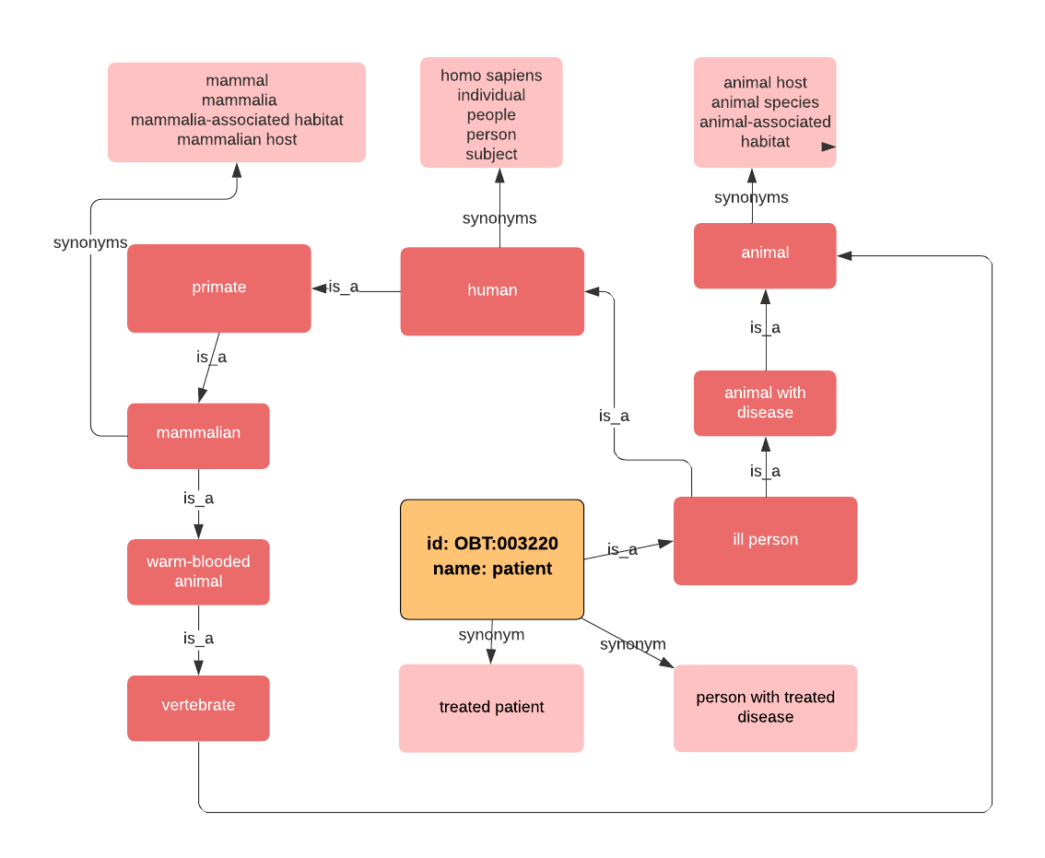
Future Work(1)
Graph based representation
of Ontology set
Using is_a/synonym relations
given in OntoBiotope dataset

Slide 18
Future Work(2)
BioWordVec [2,3]
Uses subword tokens as n-grams of characters
To capture the meaning of sub-words, prefixes, and suffixes
Fasttext Based Word Embedding
Example
TermName: gastroenteritis patients || Found: patient || Actual: patient with infectious disease
Gastroenteritis: known as infectious diarrhea
-itis: diseases characterized by inflammation

Slide 19
Future Work(3)
Part-of-Speech (POS) Tagger to extract valuable information
Noun phrases, noun clauses (NN)
Examples
TermName: sexually transmitted infection clinics || Found: patient with infectious disease || Actual: clinic
TermName: marine organisms || Found: marine environment || Actual: living organism

Slide 20
References
[1] C. D. Manning, P. Raghavan, and H. Schütze, Introduction to Information Retrieval. Cambridge: Cambridge University Press, 2008.
[2] Zhang, Y., Chen, Q., Yang, Z. et al. BioWordVec, improving biomedical word embeddings with subword information and MeSH. Sci Data 6, 52 (2019). https://doi.org/10.1038/s41597-019-0055-0
[3] "ncbi-nlp/BioSentVec", GitHub, 2020. [Online]. Available: https://github.com/ncbi-nlp/BioSentVec. [Accessed: 21- Jun- 2020].

Slide 21
Thanks

